Slide 1

MATS, Gas Switching, and the coal crunch
NAPCO Fall 2015 Credit Conference September 16-18 Denver, Colorado Steve Piper – Director, Energy Research
This document is confidential and is intended solely for the use and information of the SNL Financial and the individual, group, or corporation to whom it is addressed.

Slide 2
About SNL Energy
Leading energy news and data provider based in Boulder, CO
Focus on power, coal, and natural gas sectors
10,000+ stories published each year
In-depth data ranging from company financials to plant operational data to a suite of traded and proprietary commodities indexes
Continuous coverage of the development space with daily tracking of generation, transmission, emissions controls, pipeline, storage, and coal retirement developments
Notes:
2

Slide 3
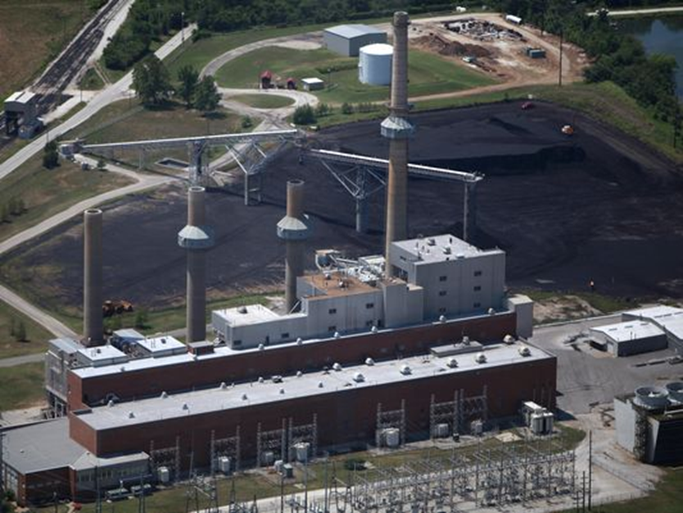
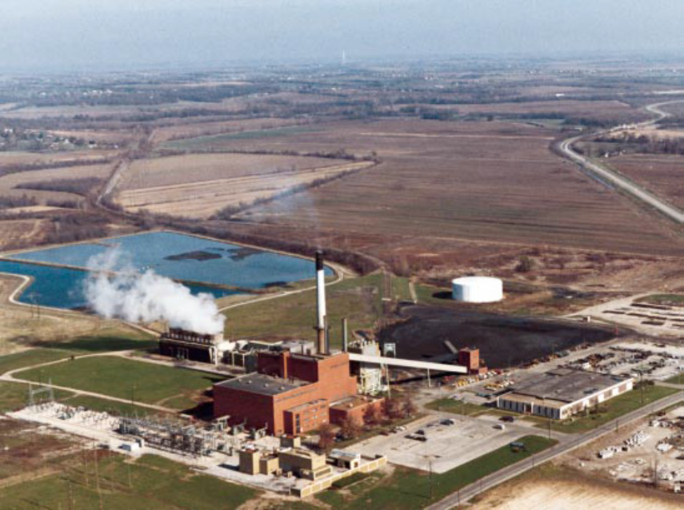
James River Power Station and Blue Valley Plant in Missouri
Each originally designed for primarily natural gas use in the 1950’s-1960’s
Forced to convert to coal in 1970s due regulations on gas use in power production
Both converting back to natural gas due to EPA MATS rules
Notes:
3

Slide 4
Mercury/Air Toxics Standards
Retrospective Impacts

Slide 5
Mercury and Air Toxics Rule (MATS) recap
History rooted in Clean Air Act of 1990 which expanded EPA authority to regulate pollutants from power plants under section 112
Finalized on December 21, 2011
At the heart of the rule are limitations on emissions of heavy metals such as mercury and acid gases including hydrochloric and hydrofluoric as well as particulates
References to the rule focus on mercury but regulation of acid gases and particulates heavily influence compliance costs
Rule remanded by the Supreme Court on June 29, 2015
Notes:
5

Slide 6
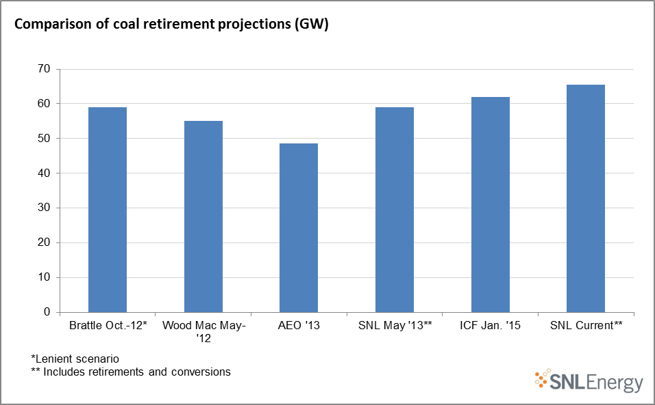
Comparison of coal retirement projections
Most projections in the 50 GW to 60 GW range
Later projections generally show increased retirements
Expect ~66 GW of retirements and conversions 2012-2021

Slide 7
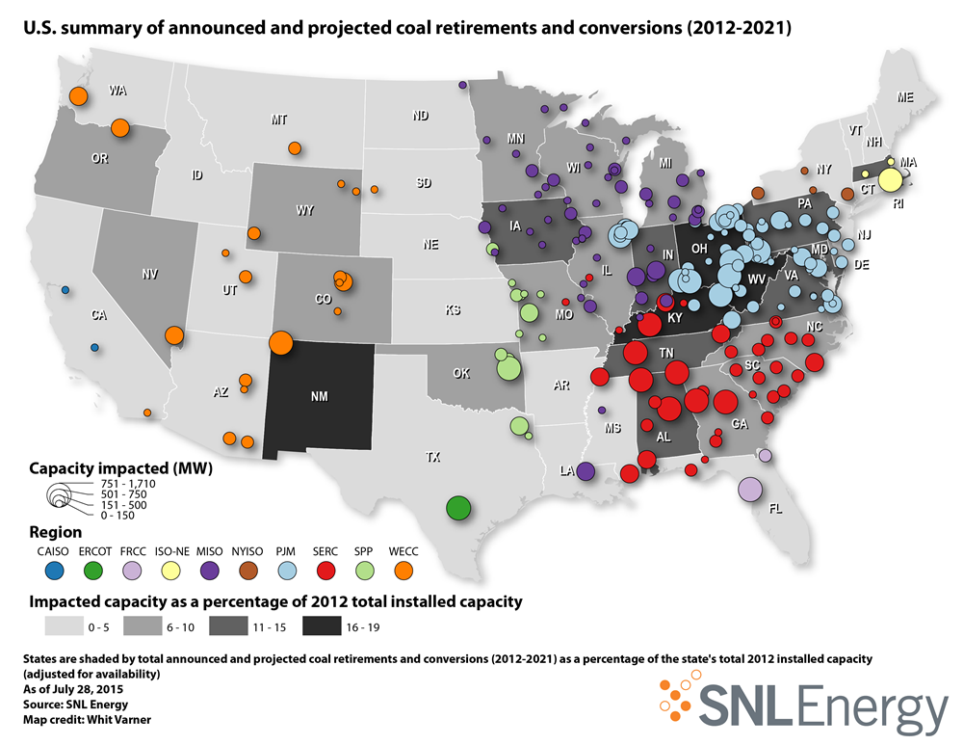
SNL Energy projected coal retirements/conversions
Notes:
7

Slide 8
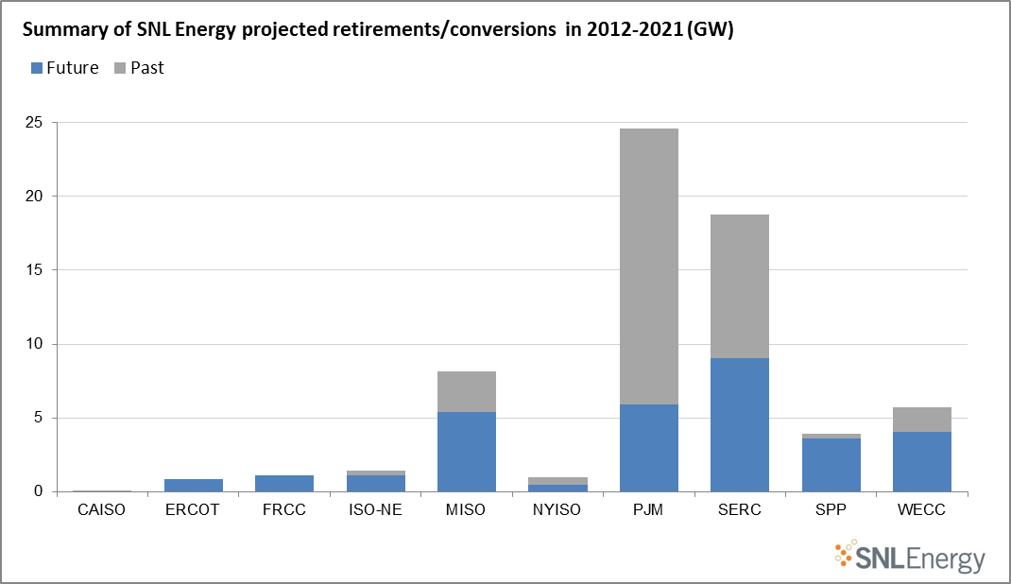
Retirements and conversions by region
PJM and southeast most impacted
MISO retires far less than the 12 GW expected by ISO
Most retires still to come in MISO, SPP and WECC
Notes:
8

Slide 9
Makeup of retirements and conversions
A little over half of retires/converts completed. Most future retires from regulated sector
Initial retires smaller and less utilized
32% more MWh from upcoming retires than past
Notes:
9

Slide 10
Top companies with future retirements
Two-thirds of future retires from 10 largest companies
TVA will see ~5 GW retiring as part of EPA settlements
NRG with nearly 4.3 GW mostly from conversions in PJM
Notes:
10

Slide 11
Coal burn from retiring units
47% more coal burn from upcoming retires than past
PRB makes up ~50% of coal burn from future retires
Again, PJM and Southeast most impacted
Notes:
11

Slide 12
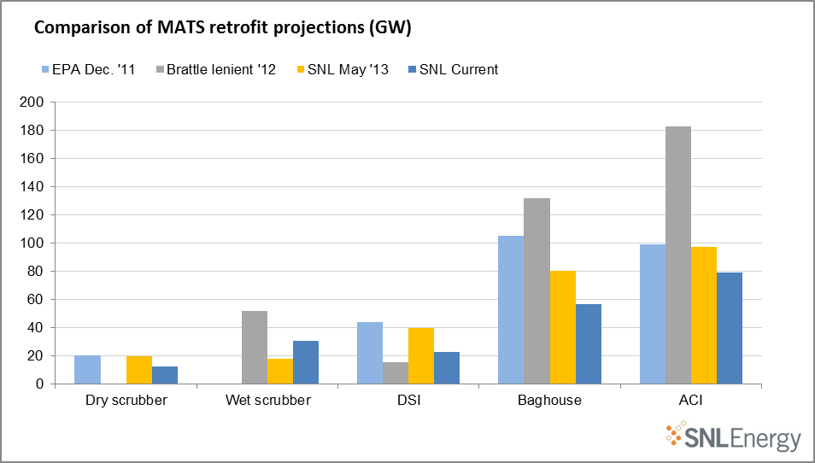
Comparison of MATS retrofit projections
Lowered expectations for nearly all retrofits under latest SNL study
FF and DSI well below expectations as PRB complies with low HCL coal
ACI projections down but technology still widely utilized

Slide 13
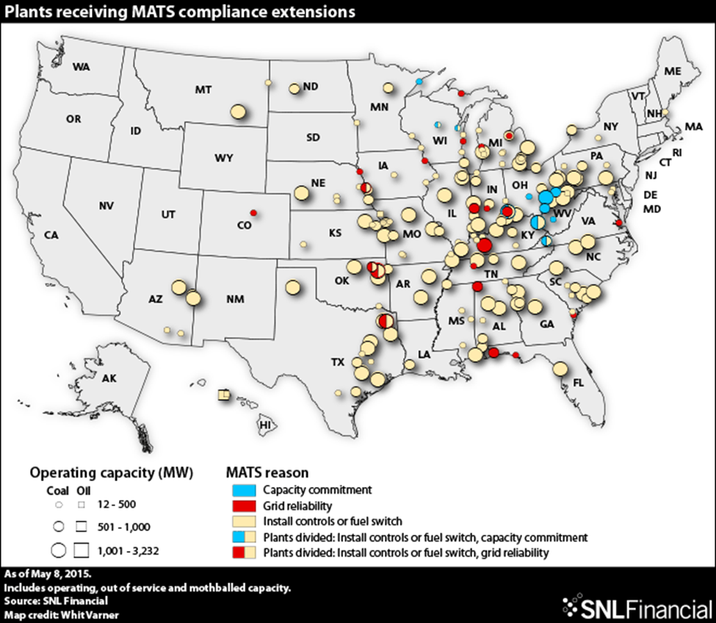
Coal unit MATS extensions by reason for extension
Roughly 157 GW granted MATS extension
Most extensions granted for installation of controls
Texas leads all states with 17 GW granted
Notes:
13

Slide 14
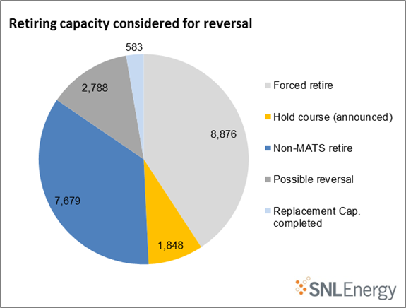
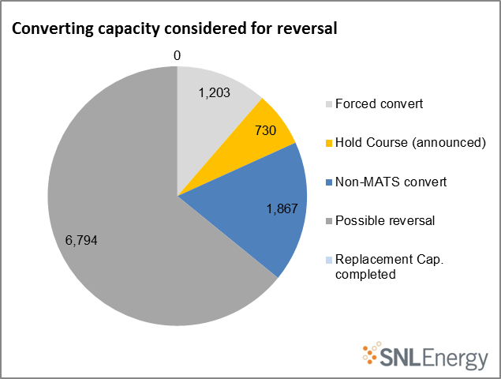
Retirement and conversion reversal potential
Consent decrees and actions for other rules holding back reversal of retires
More potential for conversion reversal at ~7 GW

Slide 15
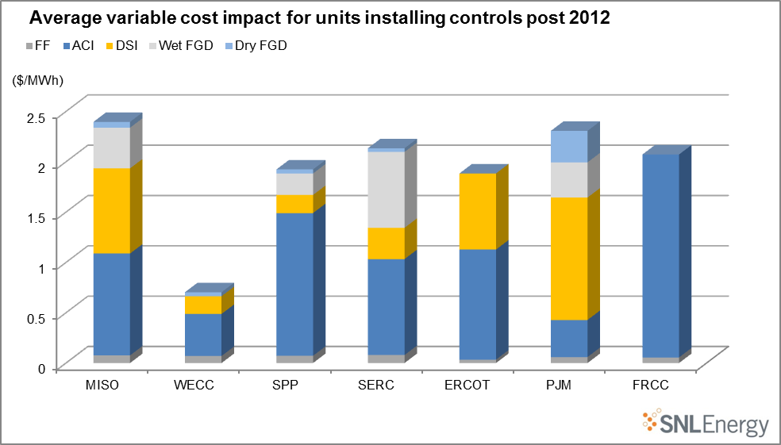
Variable cost impact from MATS controls
DSI and ACI both costly on VOM basis
New controls increase VOM ~$2.00/MWh
ACI shows biggest impact followed by DSI

Slide 16
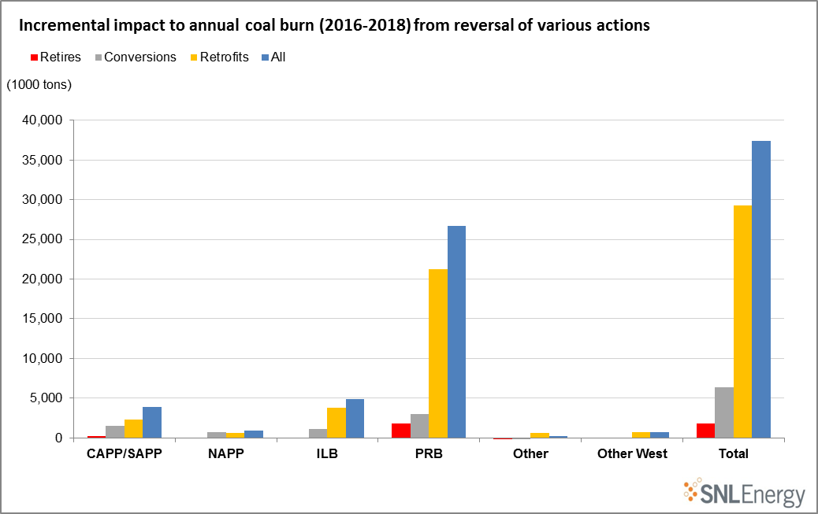
Impact to coal burn from reversal of some MATS decisions
~2 million tons given back from retires ~6 million from conversions
Vast majority of impact depends on not running controls
PRB shows the most potential
Notes:
16

Slide 17
Could we see this much incremental impact?
Few companies openly suggesting reversal of actions so far. Westar will stop projects until rule clarified, City of Grand Island may not run controls
Many controls installed due to consent decree
CSAPR, Regional Haze Rules and NAAQS continue to drive some controls
Most potential may be from not running ACI (few states with mercury rules) followed by DSI (not typically built under consent decree or other rules)
Some potential in coal-to-gas conversions (NRG retaining ability to burn coal at converted units)
Notes:
17

Slide 18
Clean Power Plan Rule – preliminary observations
From proposed to final rule, EPA took steps to ease both the legal and political obstacles
  Initial compliance deadline moved from 2020 to 2022, in exchange for a more ambitious final target
  Energy Efficiency ‘building block’ dropped as a compliance criterion
EPA relies on an expansive definition of ‘existing sources’ for its 111(d) authority
  Several legal challenges are plausible and likely
SNL Energy estimates roughly half of the CPP targeted emissions reductions would be achieved absent the CPP
  Coal retirements
  Coal/gas switching
  Renewable electricity growth via mandatory state RPS programs
  Increasingly economical solar PV
Large further reductions in coal generation would be needed to fully meet targets
Notes:
18

Slide 19
State of Coal Markets
Looking Ahead

Slide 20
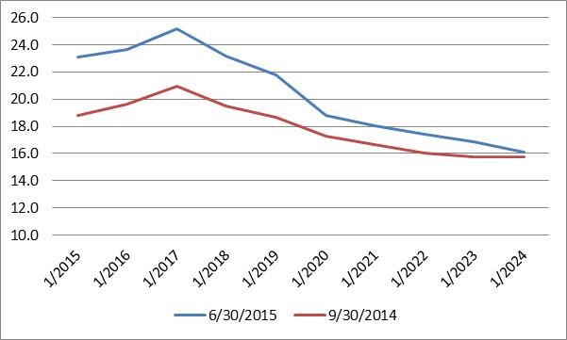
PJM – Power markets are learning to live without coal
SNL Forecast reserve margins, 2014-2015
Near-term peak demand expectations reduced ~4,500 MW
Despite 8 GW of coal retirements this year, expected reserve margins have grown dramatically
Capacity Performance Proposal eliminates 1 GW of demand response in 2018-2019

Slide 21
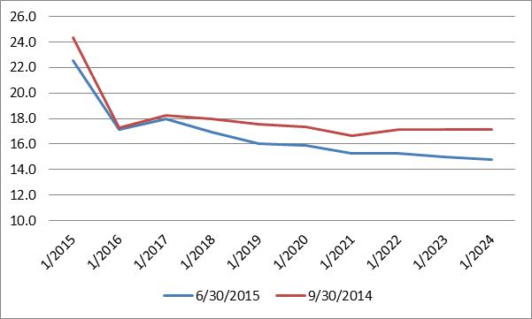
MISO – MATS retirements may tighten the region to a greater extent than PJM
Many MISO coal plants are under MATS extensions
4,900 MW of coal expected to retire next year
Another 3,000 MW will convert to natural gas
MISO demand revised upward 850-1,100 MW

Slide 22
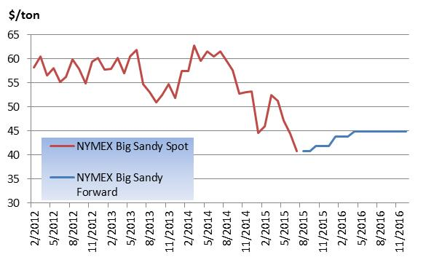
Steam Coal Pricing Trends – CAPP
Collapse in natural gas prices has since fall 2014, forcing discounts below cash costs (~$55/ton)
Prospects for near-term price recovery appear dim

Slide 23
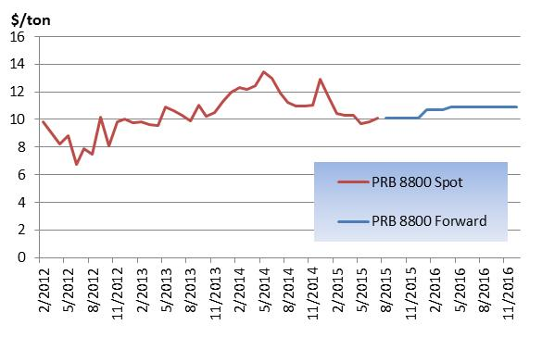
Steam Coal Pricing Trends – PRB
Forced to discount in 2012 as natural gas moved south of $2.50/mmBtu
PRB pricing is more resilient to natural gas at today’s prices
If shale gas penetrates to the Mississippi River, these markets could come under pressure as well

Slide 24
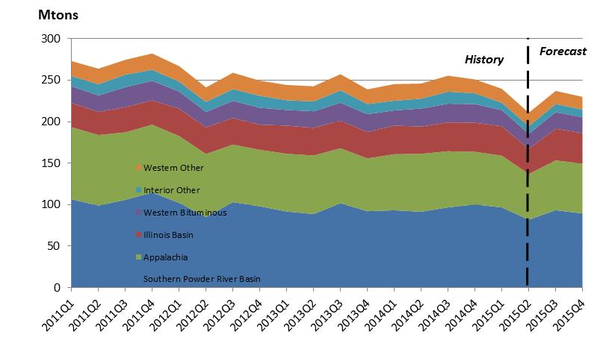
Coal production history and balance of 2015 forecast
Source: SNL Energy
Inventory refill sustained volumes in Q1
Q2 fall off is comparable 1H 2012 (30-40 Mtons)
Likely start of a substantial stepdown for coal generation demand

Slide 25
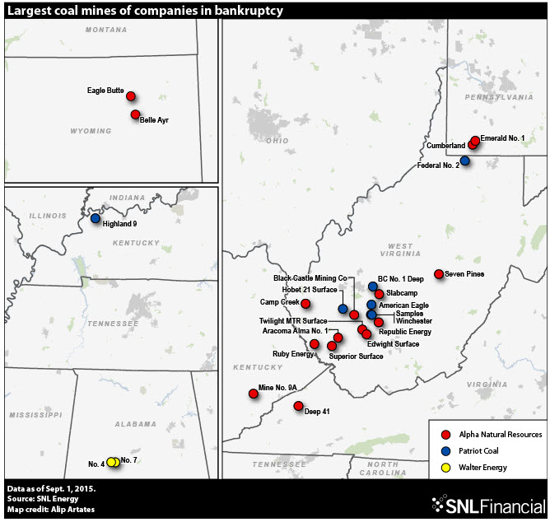
Producer bankruptcies over the past year
Alpha Natural Resources
Patriot Coal
James River Coal
Walter Energy
Numerous small private producers
Notes:
25

Slide 26
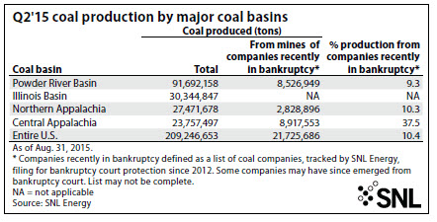
One-tenth of today’s coal production is in receivership
Notes:
26

Slide 27
Takeaways and closing remarks
Most of the tonnage lost from MATS implementation appears irreversible, regardless of current legal challenges
  Modest potential from not running controls but likely limited
MATS has been a major driver of decisions but has had help from region-level environmental regulations
  Texas and Illinois may be next areas to see coal plant shutdowns
Fewer major controls installed than was expected early on
  71 GW have not installed major controls since 2010 and are older than 40 years
  Path Dependency- This may have implications for the next wave of retirements
Combination of regulation-driven costs and shrinking margins has shrunk the domestic steam coal market
  Producers under severe financial pressure
Notes:
27

Slide 28
Thank you!

